Slide 1
Touch Screen Wireless Connected Articulating Borescope
Tuesday May 7, 2019
Michael Hong
Oasis Scientific Inc.

Slide 2
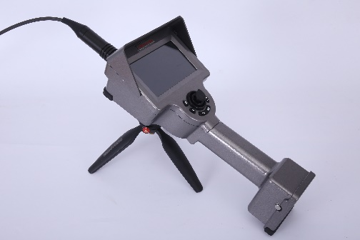
Vividia® ET Series Touch Screen HD Articulating Borescopes
Unique Features
5” touch screen monitor
Wireless (Bluetooth or WiFi) connection to phones and tablets
Image analysis, PDF inspection report
Portable and easy to operate
Motorized joystick articulation; back to original position automatically
Available diameters: 2.8mm; 3.9mm; 4.3mm; and 6.0mm

Slide 3
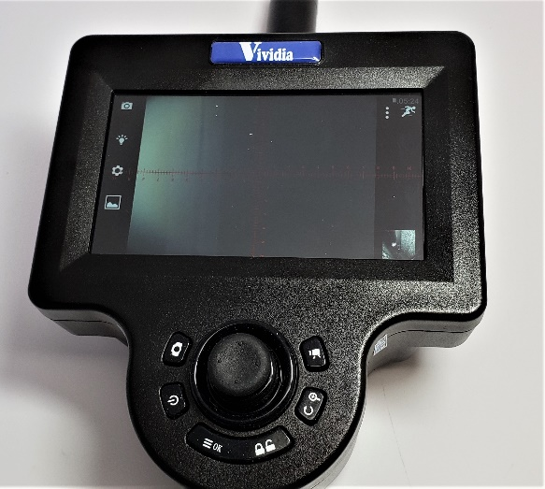
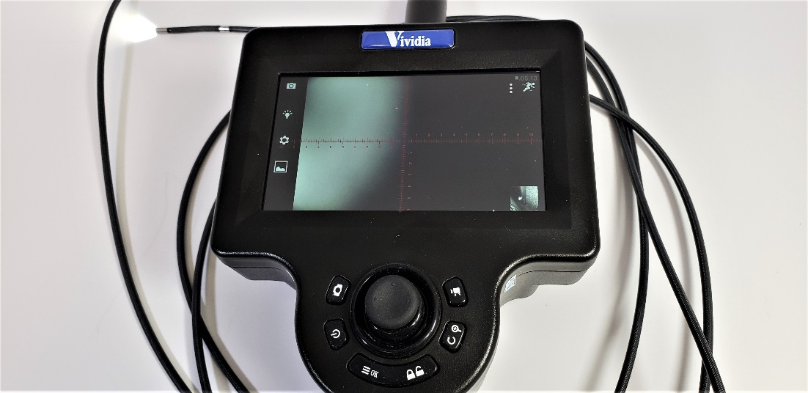
Vividia® ET Series Touch Screen HD Articulating Borescopes
Motorized joystick 360 degree articulation
Automatically go back to default straight position

Slide 4
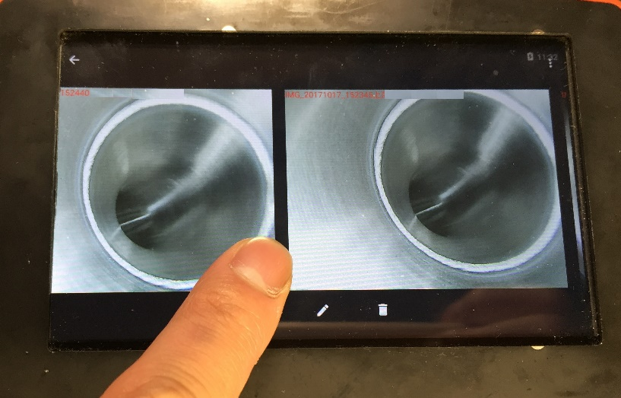
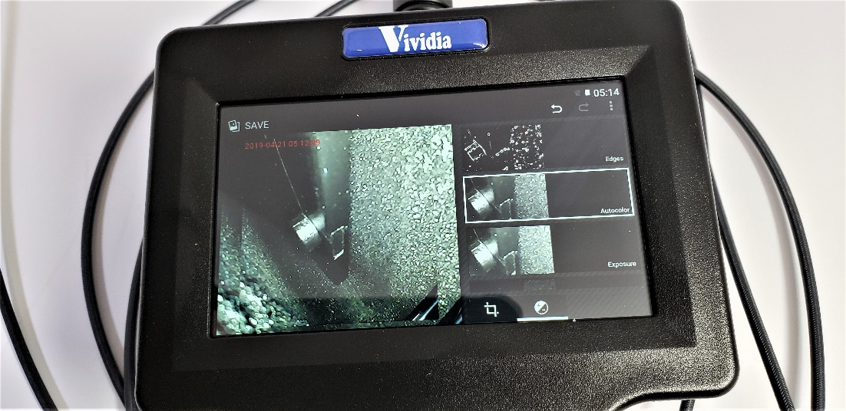
Vividia® ET Series Touch Screen HD Articulating Borescopes
Image Analysis
Comparison; Edge analysis; Color adjustment; Drawing etc.

Slide 5
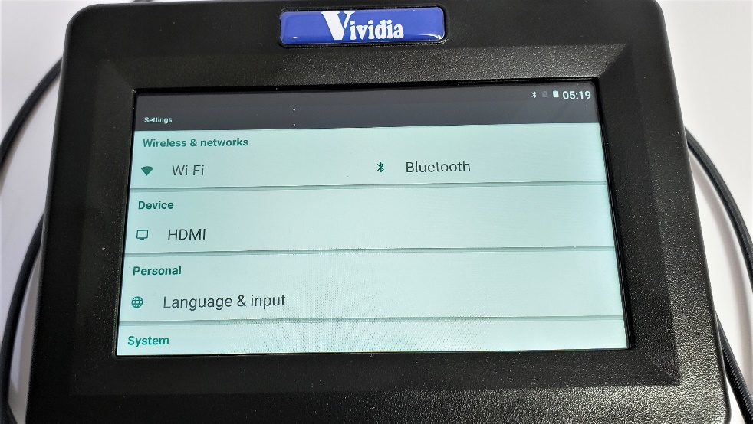
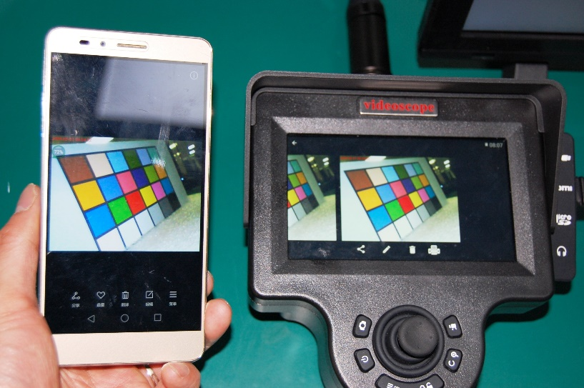
Vividia® ET Series Touch Screen HD Articulating Borescopes
Wireless connection to other devices

Slide 6
Vividia® ET Series Touch Screen HD Articulating Borescopes
Applications
PT6 engine borescope inspection
V2500 engine inspection
Annual and routine maintenance inspection
Pre-buy inspection
Internal combustion engine inspection

